Slide 1
An overview of DEEP LEARNING IN MEDICAL IMAGing focusing on mri -BRAIN TUMOR
Batch no:17
Presented By:
18RJ1A0508 :B.VAMSHI KRISHNA
18RJ1A0525:K.PRABHU TEJA
16RJ1A0582:J.V.S THARUN
Under the Guidance of :
Ms M.Lakshmi Priyanka
.

Slide 2
CONTENTS
INTRODUCTION
ABSTRACT
EXISTING SYSTEM
PROPOSED SYSTEM
SOFTWARE REQUIREMENTS
HARDWARE REQUREMENTS
SYSTEM ARCHITECTURE
MODULES
CONCLUSION

Slide 3
Introduction
Brain tumor is one of the most dangerous diseases which require early and accurately detection methods.
Machine learning algorithms have the potential(showing the capacity )to be invested deeply in all fields of medicine, from drug discovery to clinical decision making, significantly altering the way medicine is practiced.
The main purpose of this project is to be build a robust CNN model that can classify if the subject has a tumor or not based on Brain MRI scan images.

Slide 4
Abstract
The tremendous (great)success of machine learning algorithms at image recognition tasks in recent years intersects with a time of dramatically increased use of electronic medical records(information about a patient's health history )and diagnostic imaging.
This review introduces the machine learning algorithms as applied to medical image analysis, focusing on “convolutional neural networks”.
We cover key research areas and applications of medical image classification, detection, segmentation, and registration.

Slide 5
EXISTING SYSTEM
Medical images are an integral part of a patient's EHR and are currently analyzed by human radiologists, who are limited by speed, fatigue, and experience.
It takes years and great financial cost to train a qualified radiologist, and some health-care systems outsource radiology reporting to lower-cost countries such as India via tele-radiology.
A delayed diagnosis causes harm to the patient.

Slide 6
PROPOSED SYSTEM
Therefore, it is ideal for medical image analysis to be carried out by an automated, accurate and efficient machine learning algorithm.
“CNNs are the most researched machine learning algorithms in medical image analysis”.
The reason for this is that CNNs preserve spatial relationships when input images. a CNN takes an input image of raw pixels, and transforms it via Convolutional Layers, Rectified Linear Unit (RELU) Layers and Pooling Layers. This feeds into a Fully Connected Layer.

Slide 7
SOFTWARE REQUIREMENTS
OS : Windows
Language : Python[version:3.7.0]
IDE : PYCHARM

Slide 8
HARDWARE REQUIREMENTS
RAM : 4GB and Higher
Processor : Intel i3 and above
Hard Disk : 500GB: Minimum

Slide 9
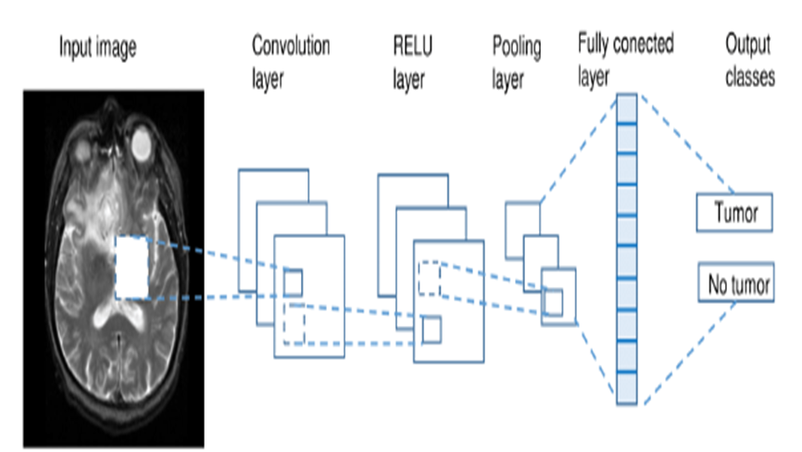
System Architecture

Slide 10
Use Case DIAGRAM
Upload Image
Dataset
Generate Images
Train & test
Generate DL
CNn Model
USER
Get drive Hq
images
Predict Tumor

Slide 11
Sequence Diagram

Slide 12
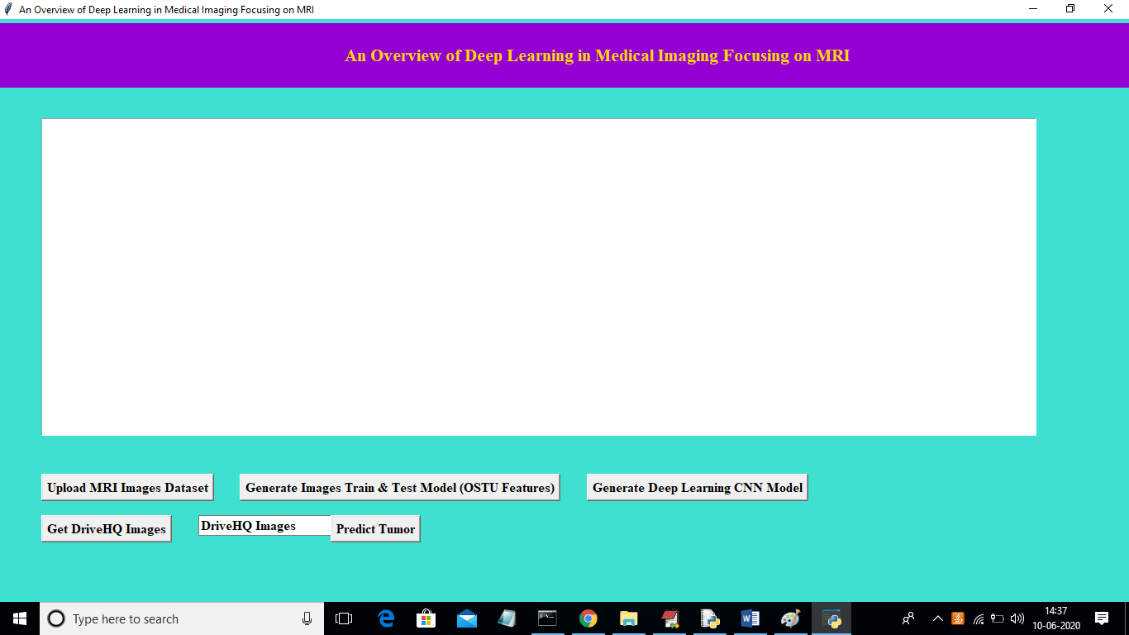
Home Page

Slide 13
MODULES
“In this project we are using brain tumor MRI images to build deep learning auto stack CNN model. To implement this project we are using following modules”
UPLOAD DATASET
GENERATE TRAIN& TEST MODEL(OTSU FEATURES)
GENERATE DEEP LEARNING CNN MODEL
GET DRIVE HQ IMAGES

Slide 14
Upload dataset
Using this module we are uploading MRI train images and then application read all images and convert them grey format.

Slide 15
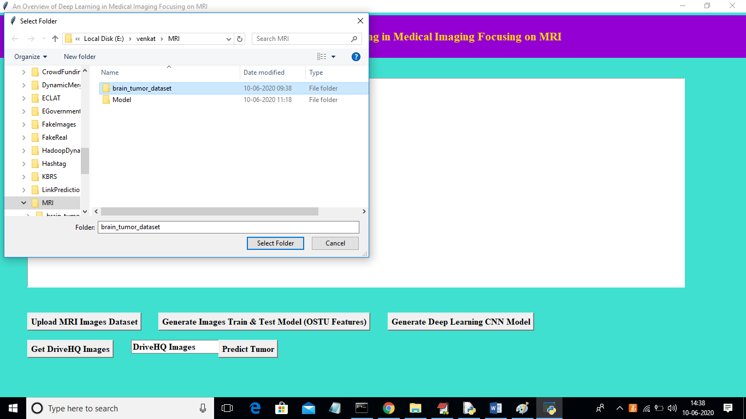
Upload Dataset

Slide 16
Generate Train & Test Model
OTSU FEATURE
we will apply OTSU Thresholding technique on each image to extract features.
Using this we will build array of pixels with all images features and then split dataset into train and test model to calculate “accuracy” using test images by applying train model on it.

Slide 17
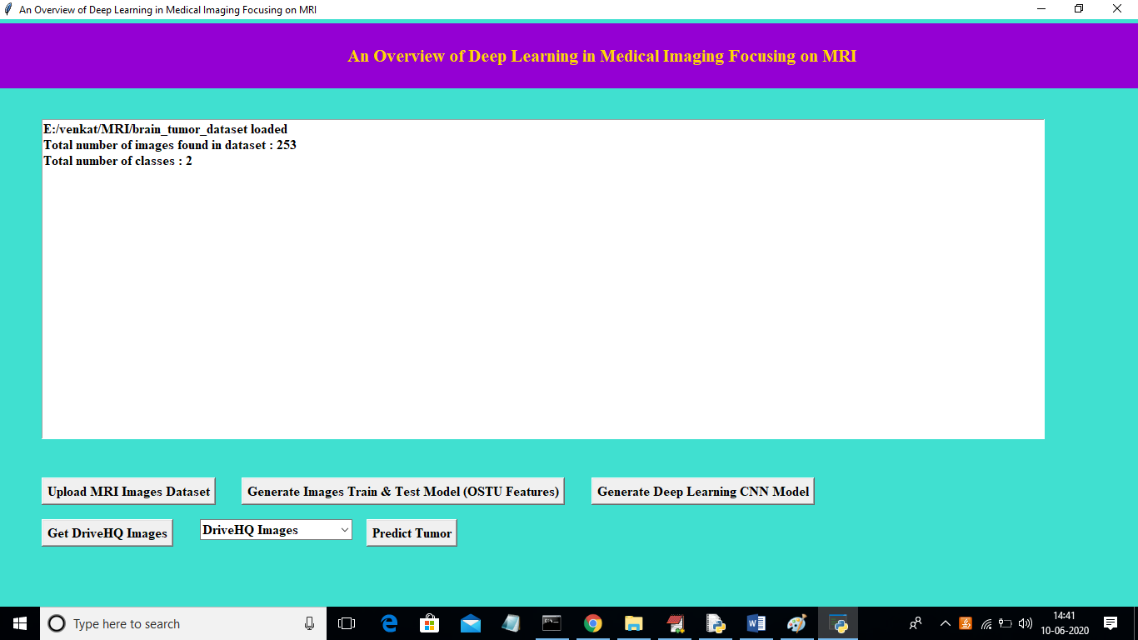
Generate Train and Test Model

Slide 18
Generate Deep Learning CNN Model
In this module will input train and test data to auto stack CNN model to build training classifier.

Slide 19
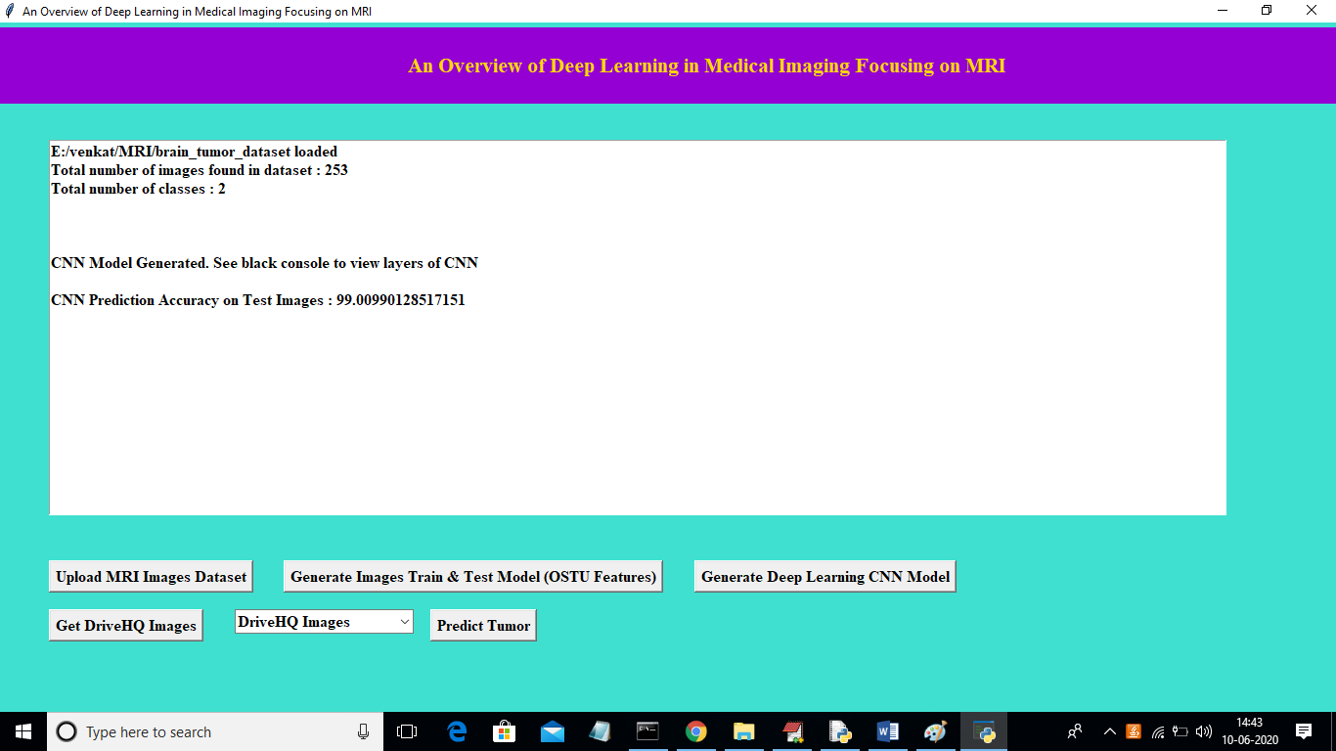
Run Deep learning Algorithm

Slide 20
Get Drive HQ Images
Using this module we will read test image from Drive HQ website and then this application will apply CNN classifier model on that test image to predict whether image contains “tumor disease or not”.

Slide 21
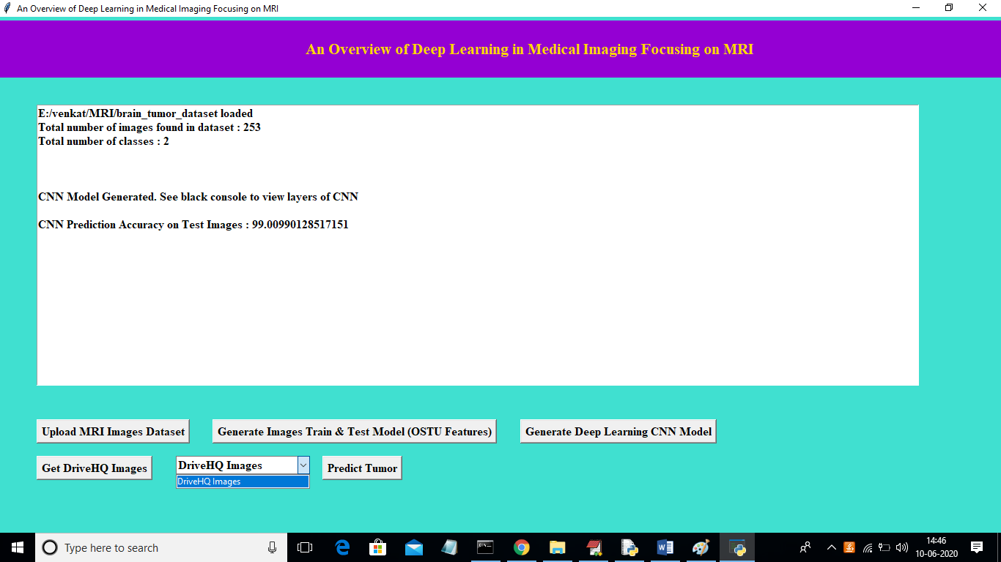
Drive HQ Images

Slide 22
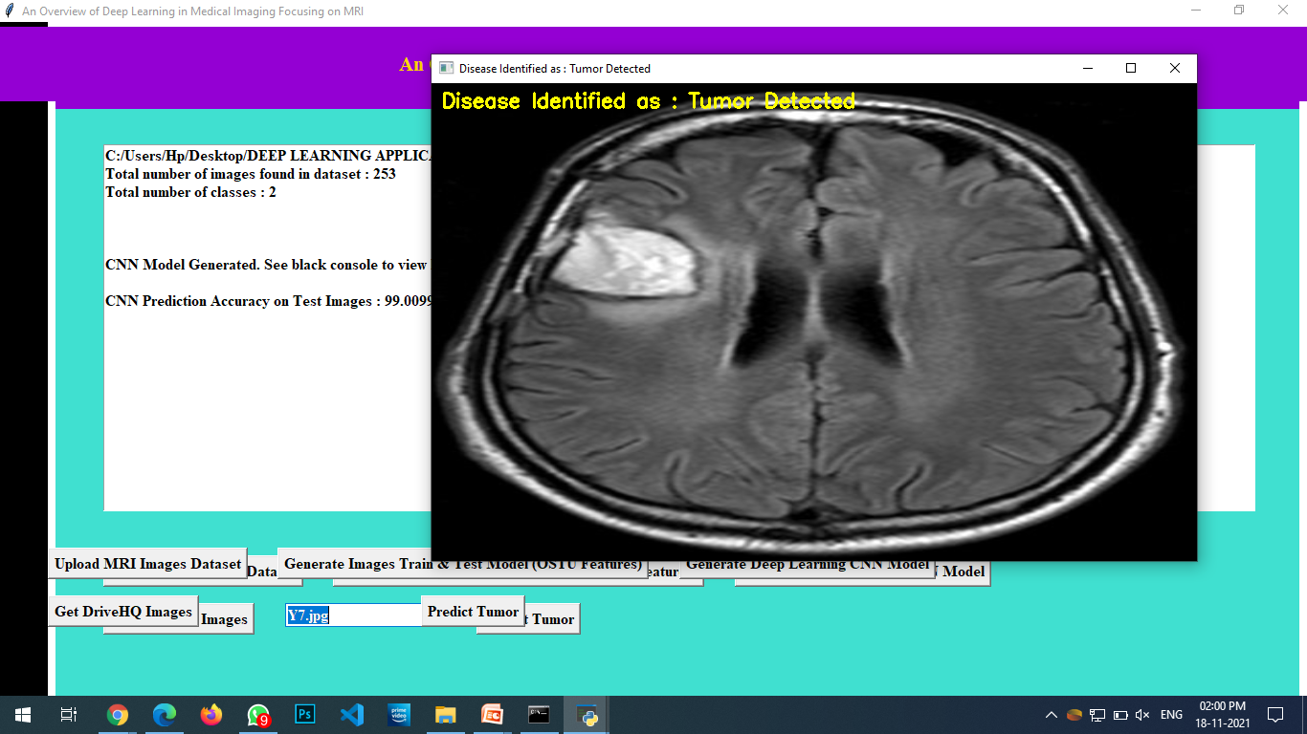
Prediction

Slide 23
CONCLUSION
We were able to create and train a model that gave us very high accuracy an unseen data using relatively low input data

